Slide 1



Anomaly Detection
On Sensor Data.
IOT.based

Slide 2



Meet our team
AHMED ELTABAKH
AMR MONEER
OSAMA AYMAN

Slide 3








Agenda
01
05
Introduction
Approaches
02
06
Challenges
Final Approach
03
07
Objective&Motivation
Use Cases
04
08
Methodology
MOT Platform

Slide 4
Introduction
Business Domain.
Business Need.
Why online Learning ?
Batch Learning VS online Learning.

Slide 5

Programming language
Limited Resources
New Terminology
No ML Support

Slide 6

Objective & Motivation
Online Learning Model
1
Machine Learning Model able to detect anomalies in sensor data and learn the new behavior from coming data over time.
2
Deploy Model
Deploy model on company platform (Master Of Things).
Solution for Real Problem
3
We develop a real solution for a company that needs to solve a problem in its domain with machine learning.
4
New subfield of ML
Now we can compare batch learning with online learning when it comes to ML.

Slide 7
Methodology
Anomaly algorithms
01
Statistical Methods
Offline learning method
Require Full Labelled Dataset
Not Adaptive
02
Distance-based methods
03
Classification-based methods

Slide 8
Methodology
Half Space Trees
01
Fast Model
Tree based algorithm
Tree structure is constructed
without any data
Constant amount of memory
Highly Efficient for IOT
02
Adaptive Model
03
Online Learning Model

Slide 9
1
X<0.5 ?
Y
N
X<0.25?
Y<0.5 ?
Y
N
Y
N
Y
Y<0.5 ?
X<0.37?
X<0.75?
Y<0.75?
Y
N
Y
N
Y
N
Y
N
1
0
2
4
5
3
0
0
1
2
0
0
0
1
0
3
7
1
8
2
4
6
5
0
0
0
X
1

Slide 10
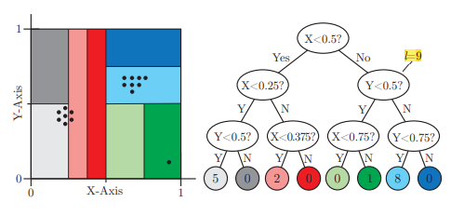
Half Space Trees
Moving average
Reference Mass
Latest Mass
Max Score
Batch of points

Slide 11
Approaches
01
Batch of points
Half Space Tree
02
Moving average
Have a lot of variations to detect anomaly point.
03
Max Score

Slide 12
Final Approach
01
More than one window
Our Enhanced Approach
02
Trees Voting
Despite high results, but we enhanced the algorithm based on the company requirements.
03
Time Window

Slide 13
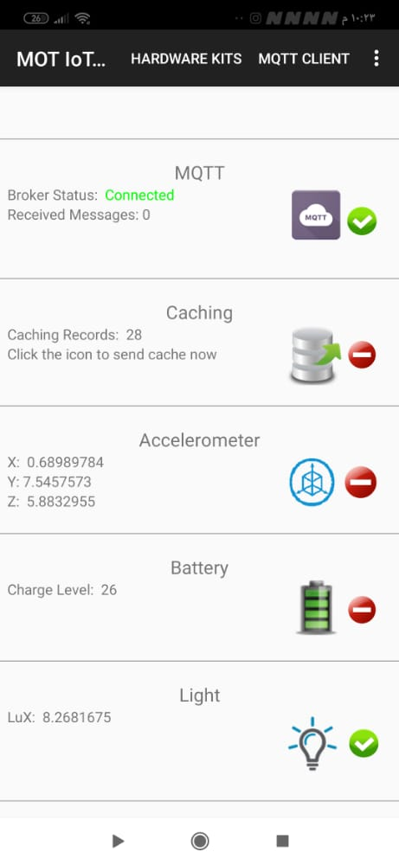
Use Cases – Mot IOT Kit
Accelerometer Sensor
Lux Sensor
Week Days vs Week End

Slide 14
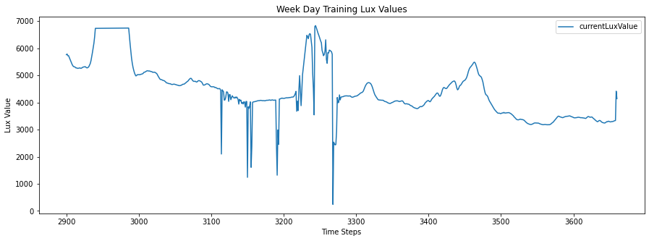
Use Cases: results-WeekDays

Slide 15
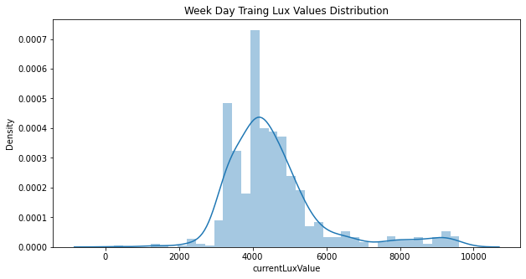
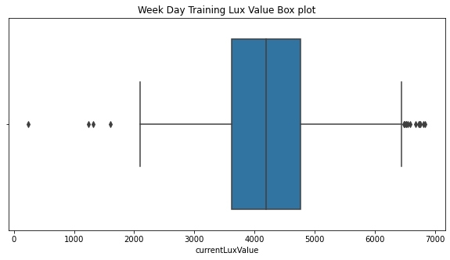
Use Cases: results-WeekDays

Slide 16
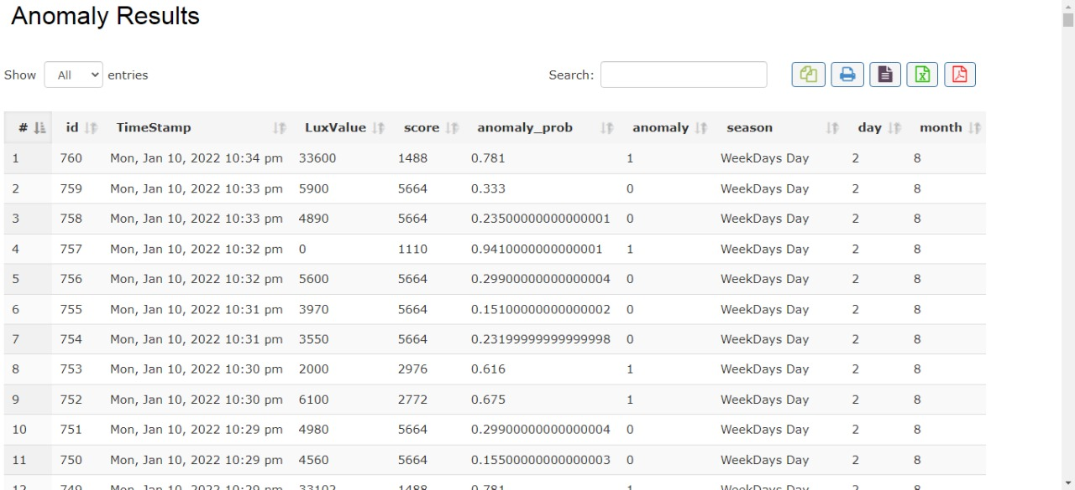
Use Cases: results-WeekDays

Slide 17
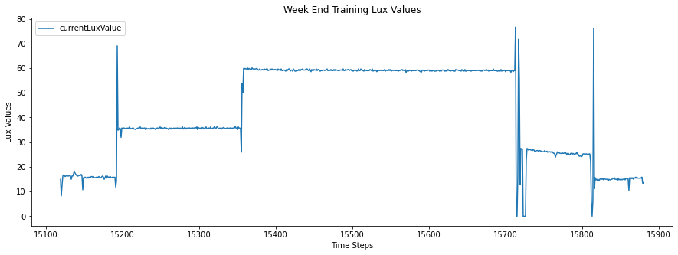
Use Cases: results-WeekEnd

Slide 18
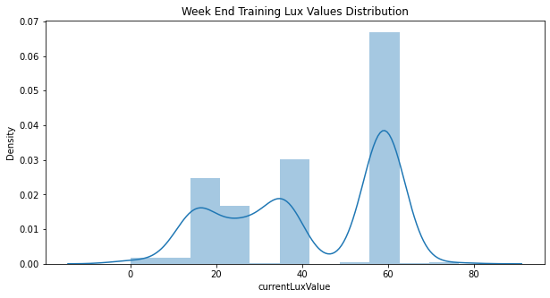
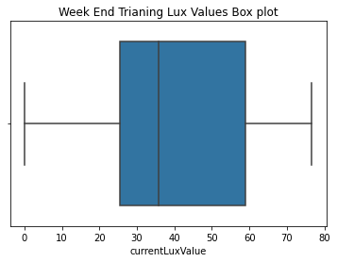
Use Cases: results-WeekEnd

Slide 19
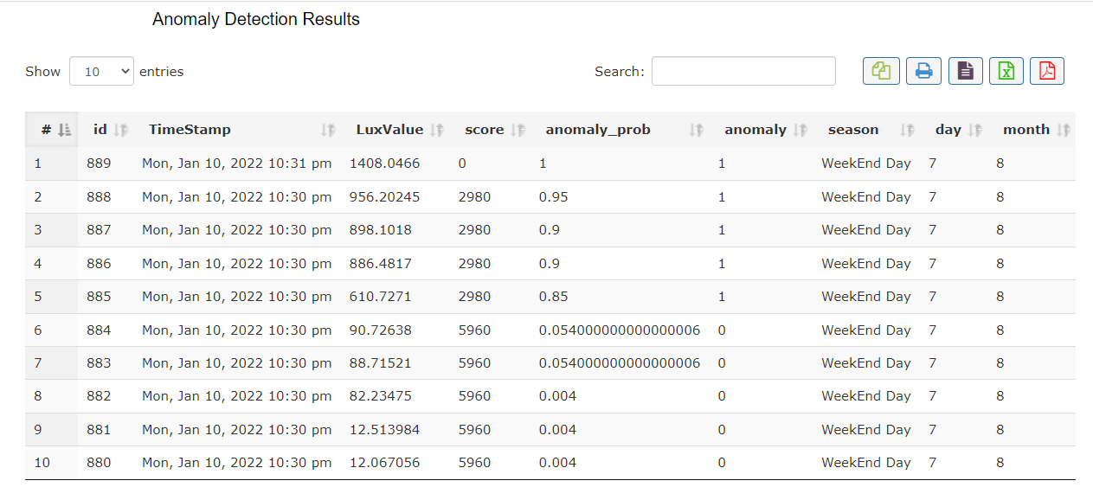
Use Cases: results-WeekEnd

Slide 20
MOT Platform
http://beta.masterofthings.com

Slide 21


